Slide 1
Simulation Steps for gm/ID
Presented by Deepa Kulkarni
Guided by Neeraj Mishra, BITS Pilani

Slide 2
Presentation topics
Generating the Look-Up Tables (LUTs)
Create a Characterization Schematic
Set up the DC Sweep in ADE
Extract and Save Key Parameters
Use Results Browser to add parameters
Create the gm/ID Curves
Parametric analysis for Different Lengths.
Ocean scripting for plotting graphs w.r.t gm/ID
Parametric analysis using ocean scripting
Plotting of gm/ID graphs on MATLAB
Run MATLAB & Parametric Analysis

Slide 3
Generating the Look-Up Tables (LUTs)
Core of the gm/ID Method
Traditional equations fail to capture short-channel effects in modern CMOS.
gm/ID method replaces equations with lookup tables (LUTs) derived from PDK simulations.
Transistors are characterized across:
  Multiple channel lengths (L)
  Different bias points (Vgs, Vds)
Provides accurate data for gm/ID, gm/gds, fT, ID/W, etc.
Enables reliable device sizing and bias selection directly from simulation data.

Slide 4
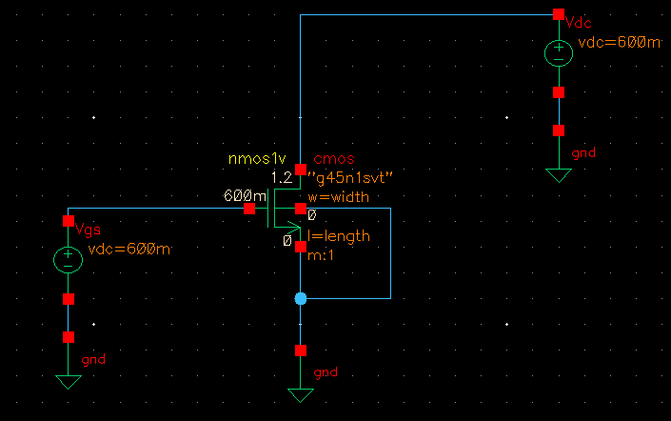
Create a Characterization Schematic
Circuit of a simple Nmos.
  Vdd/2 = Vgs = 600mV
  Keep length and width of the Nmos variable

Slide 5
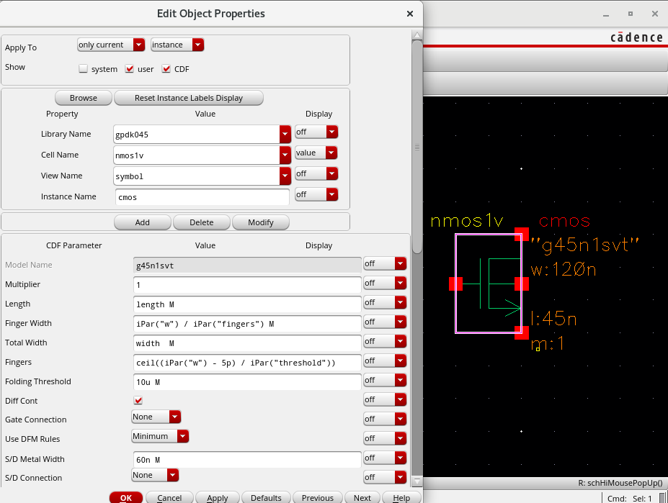
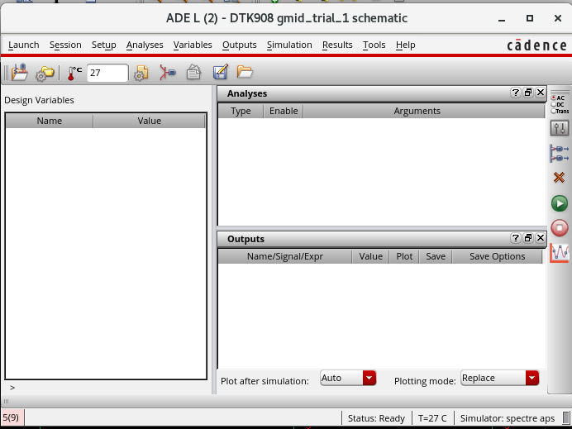
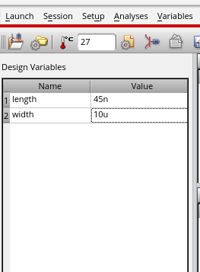
Click on Nmos > press Q > Properties.
  Type "width" in width.
  Type "length" in length.
In ADE L window,
  Go to the menu bar, Design Variables
  Right-click > Copy from Cell-view.
length=45nm
Width =10u

Slide 6
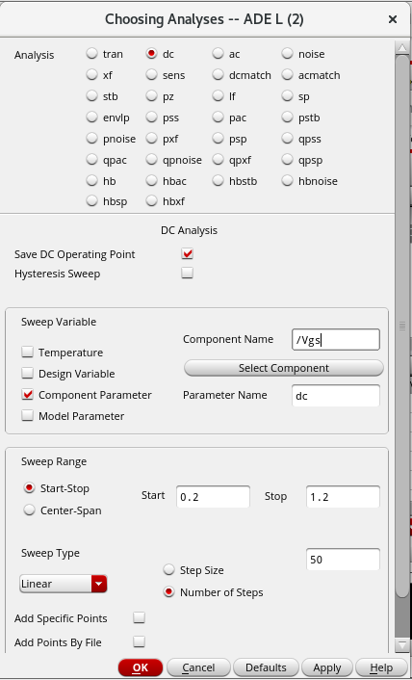
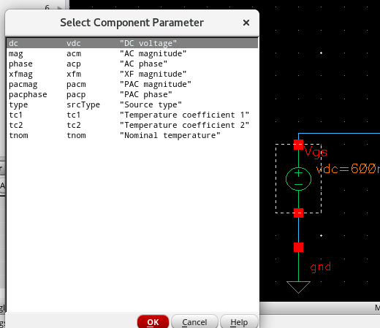
  Set up the DC Sweep in ADE
Analyses>Choose>select 'dc'.
Select 'Component parameter' > Click on Vgs
Then select dc voltage.
Fill the dc analyses as shown. > OK

Slide 7
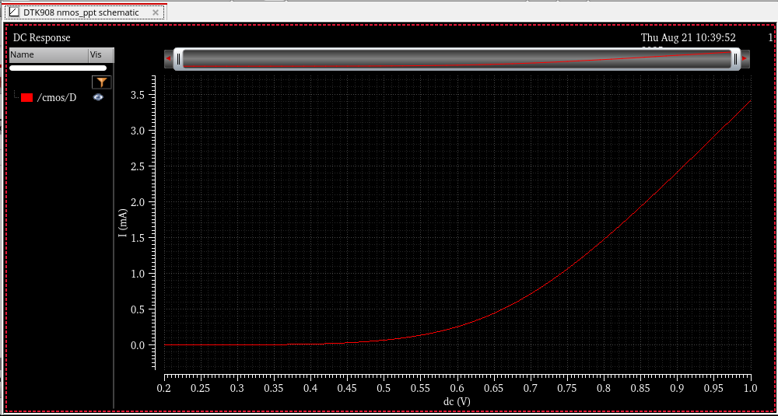
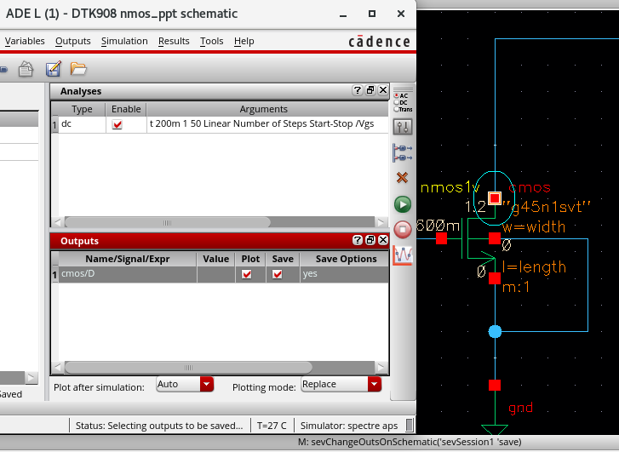
Extract and Save Key Parameters
In the ADE L window, to add the parameters:
Output>setup> Setting Outputs window pops up.
Click on 'From Design' > click on the drain of the Nmos as shown.
Click on Run to run the simulation.
Run
Expected graph of drain current vs Vgs

Slide 8
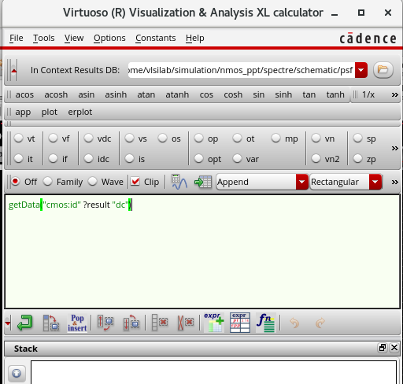
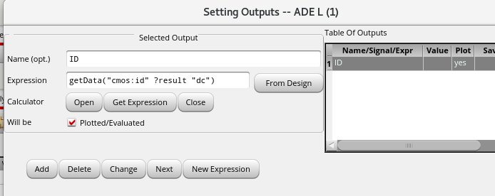
Right click on the '/cmos/D' in the graph > send to > Calculator.
In calculator, copy the expression of the cmos/D.
Go back to 'Outputs' section in the ADE L window.
Right-click on 'cmos/D' > Edit > Paste the expression.
Change the name to 'ID' > click OK

Slide 9
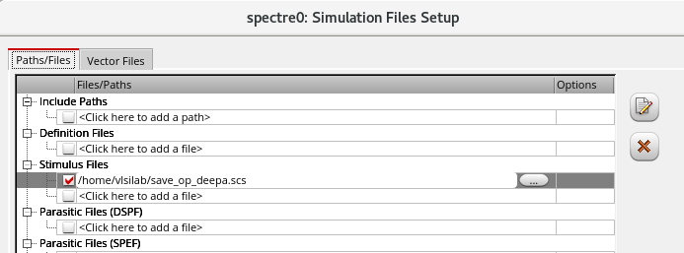
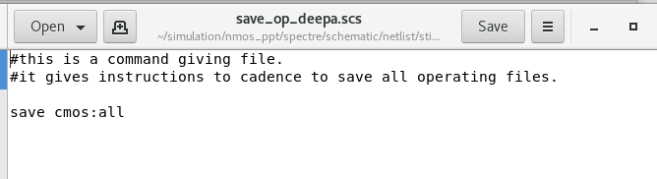
To save all the operating parameters of MOSFET, we need to make a separate file.
<name_of_file>.scs file
  Type "save name_of_mosfet:all"
  Or type "save name_of_nmos:all" to save nmos operating parameters
Import save_op_deepa.scs into Cadence as simulation file or model library file.
  In ADE L window > Setup > Simulation Files > Stimulus Files > Add path to your .scs file. > OK

Slide 10
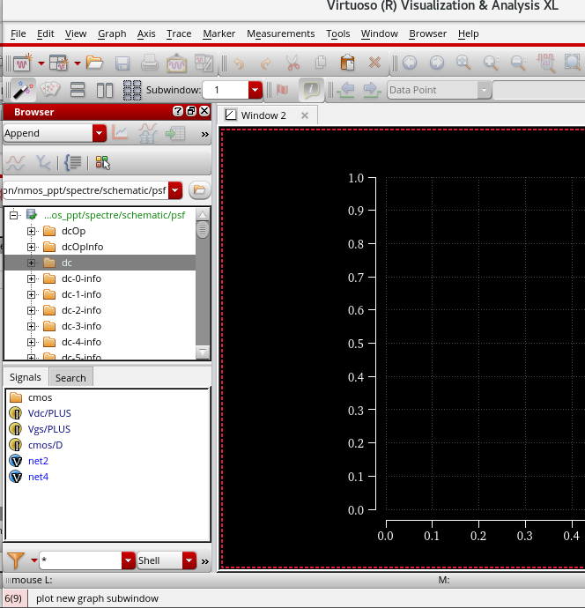
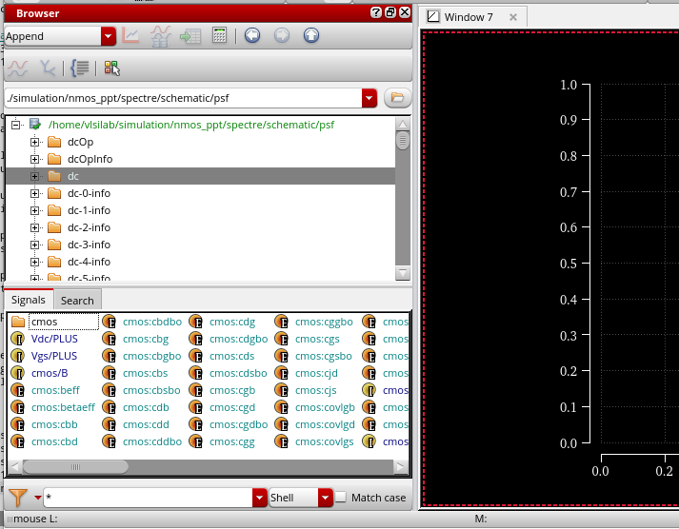
Use Results Browser to add parameters
In ADE L window, run DC analysis (deselect all the plot options).
Tools > Results Browser > In 'Signals' section > double-click on 'dc'
  All the parameters of the MOSFET are shown.
Before saving all parameters seperately.
After saving all parameters seperately

Slide 11
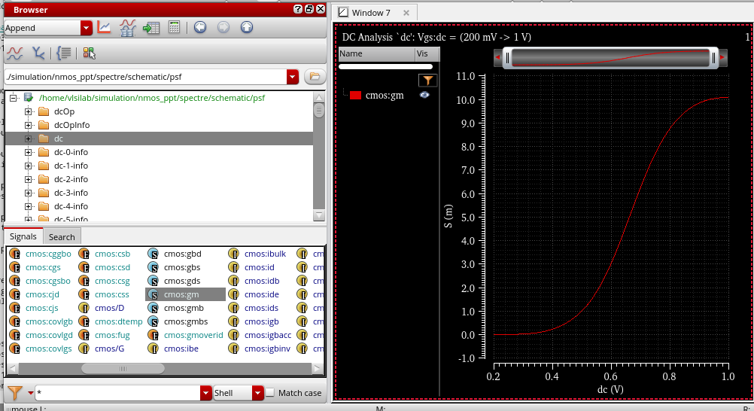
Search up cmos:gm > double click on it for gm vs Vgs graph.
Right-click on cmos:gm > calculator > Copy the expression of gm
Paste the expression in the 'Outputs' section in the ADE L window to create an output. Name it as 'gm' .

Slide 12
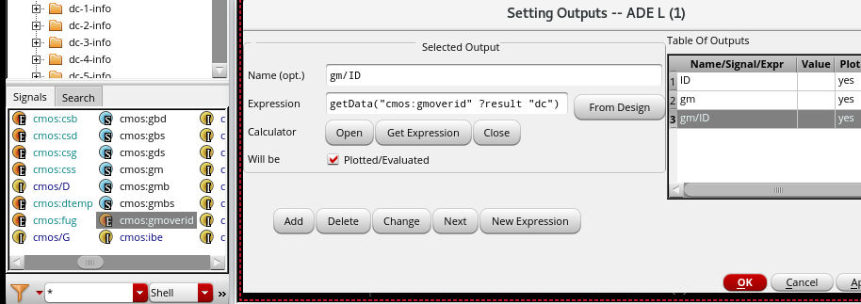
Two ways of creating gm/ID : cmos:gmoverid or divide gm by ID expressions in the calculator.
Double-click on 'cmos:gmoverid' to plot. Gm/ID vs Vgs
Total gate capacitance: Cgg | getData("cmos:cgg" ?result "dc")
Transit frequency: ft = gm/cgg | (getData("cmos:gm" ?result "dc") / getData("cmos:cgg" ?result "dc"))
Drain-to-source output conductance: gds | getData("cmos:gds" ?result "dc")

Slide 13
Add in other parameters :
Note: All the expressions are derived from the Results browser.
Ft*(gm/id) | ((getData("cmos:gm" ?result "dc") / getData("cmos:cgg" ?result "dc")) * getData("cmos:gmoverid" ?result "dc"))
Intrinsic gain : gm/gds | (getData("cmos:gm" ?result "dc") / getData("cmos:gds" ?result "dc"))
ID / W | (getData("cmos:id" ?result "dc") / VAR("width"))
Overdrive Voltage Vov = Vgs-Vth | (v("cmos:vgs" ?result "dc") - v("cmos:vth" ?result "dc"))

Slide 14
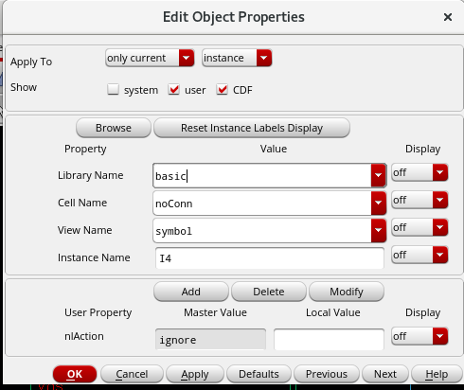
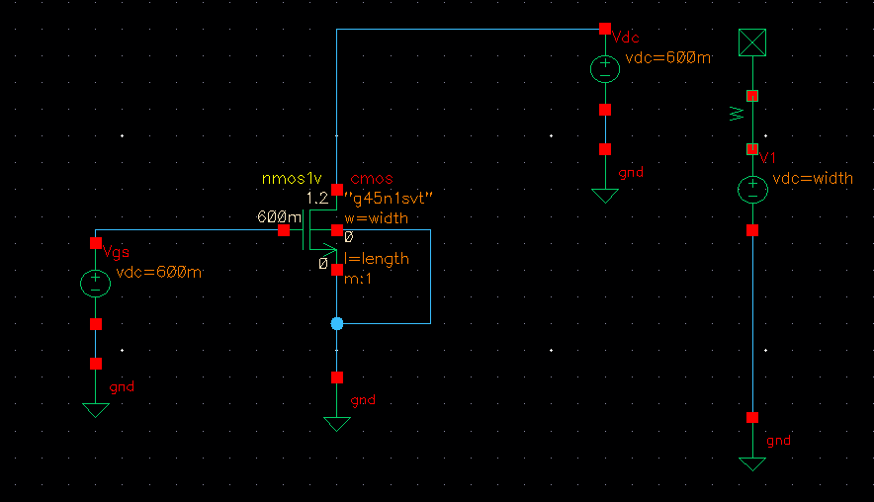
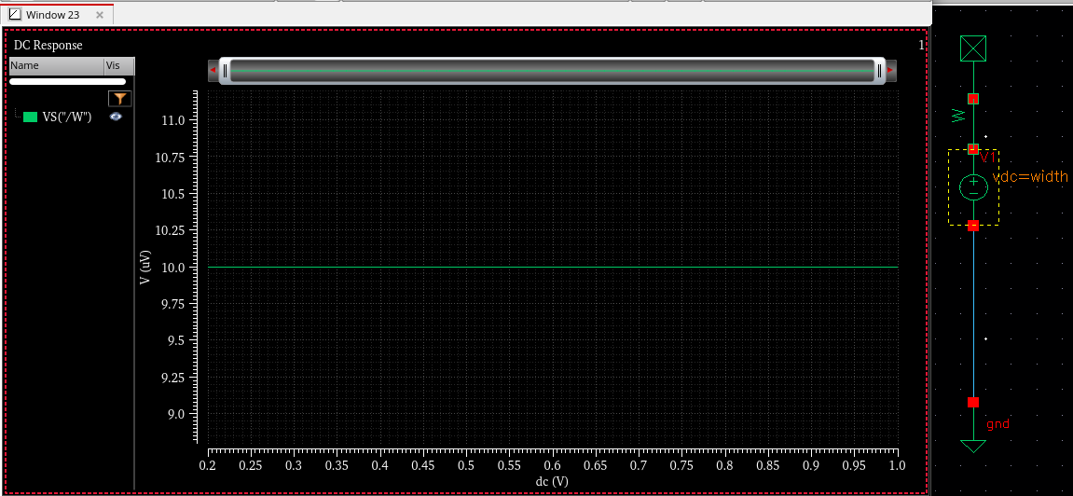
Another way to find ID/W
Dc analysis of a voltage source of voltage "W".
Connect its positive terminal to "noConn" from "basic" library.
Run DC analysis to plot W as 10u (width is given as 10u).
Right-click on the signal VS("/W") > Calculator > copy the Expression.
Get ID/W by dividing ID by the expression obtained above.
W = 10u

Slide 15
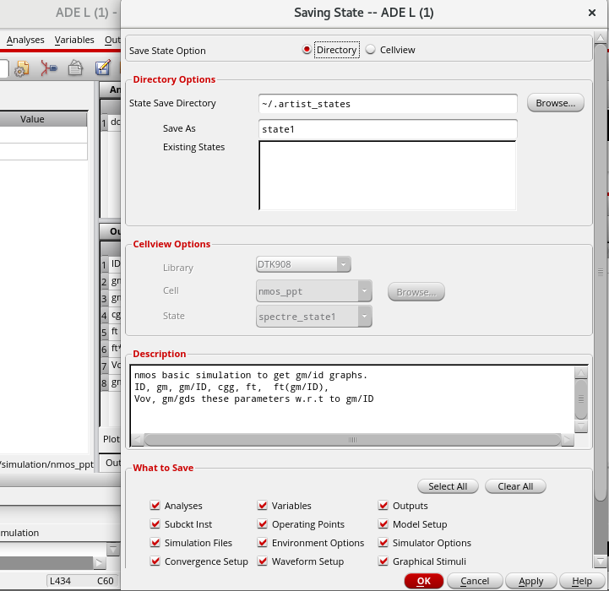
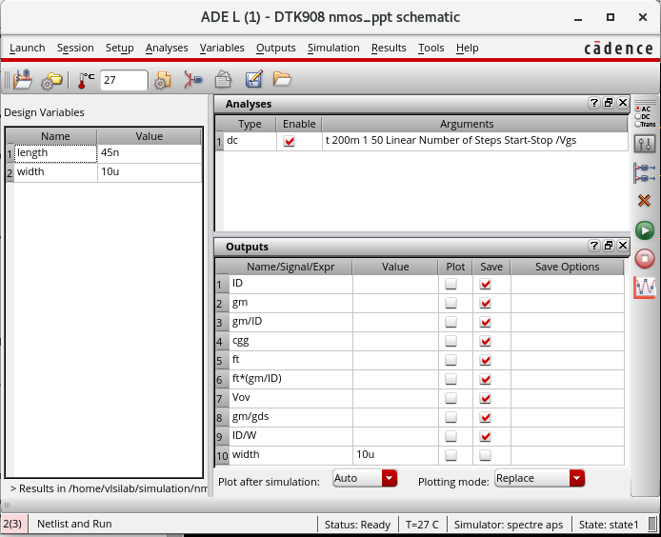
Create the gm/ID Curves
Final ADE L window. (Enable Plot for all parameters before plotting).
Save the ADE L window before moving further. ​

Slide 16
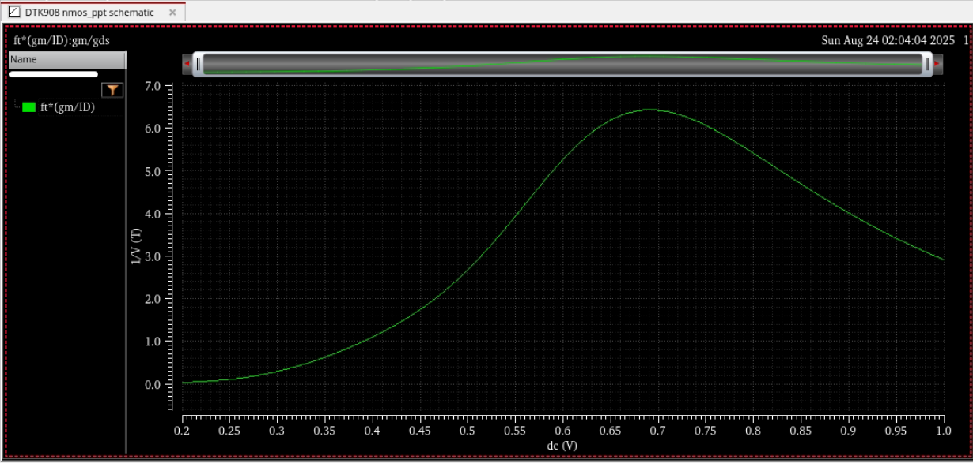
For Simulations, enable Plot for parameters you want to simulate > Run
Example: ft*(gm/ID) vs Vgs

Slide 17
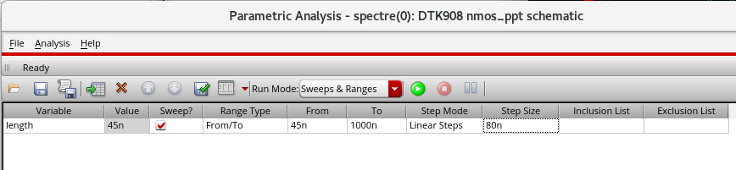
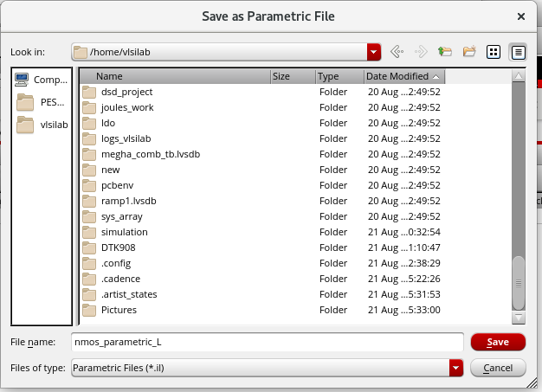
Parametric analysis for Different Lengths
Sweep all the parameters (w.r.t to Vgs for now) from 45n to 10u.
After saving the ADE L window,
  Tools>Parametric Analysis : Step-size = 80n
Save the Parametric analysis: File > Save

Slide 18
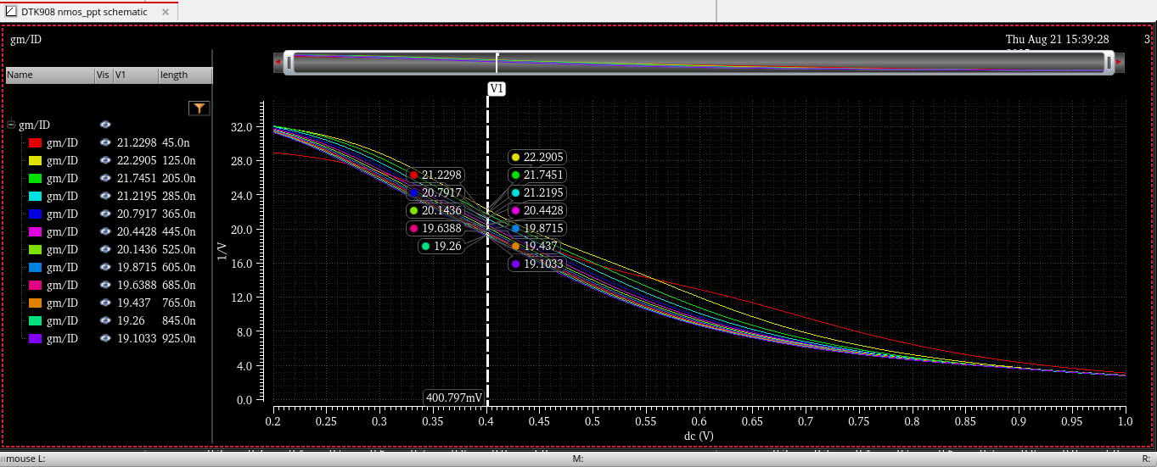
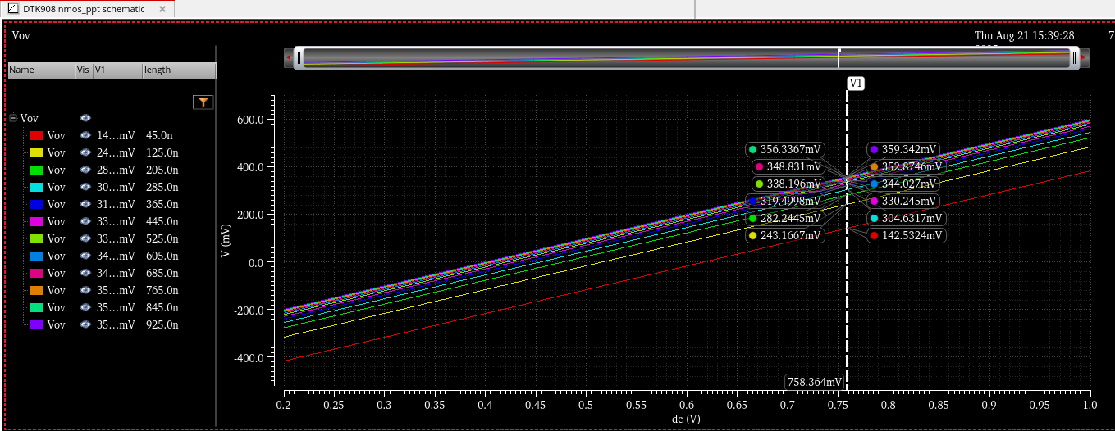
For Parametric analysis, enable 'Plot' for parameters needed.
Analysis > Start Selected/ Start all (to plot all).
Gm/ID parametric analysis vs Vgs
Vov parametric analysis vs Vgs

Slide 19
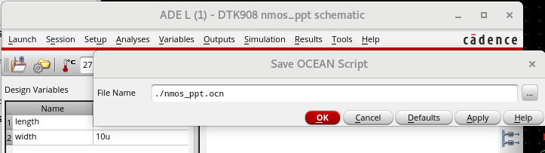
Ocean scripting for plotting graphs w.r.t gm/ID
Ocean scripting
  Automates simulations (no repetitive GUI work)
  Runs sweeps, corners, Monte Carlo in batch
  Extracts results directly (gm/Id, gain etc.,)
  Exports data for MATLAB/Python
  Saves time & reduces errors.
In ADE L window, once all the parameters are added,
Session>Save ocean scripting > Save it as <any_file_name>.ocn

Slide 20
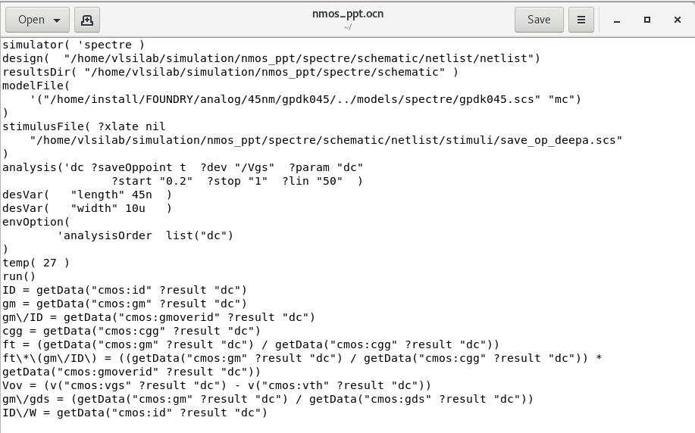
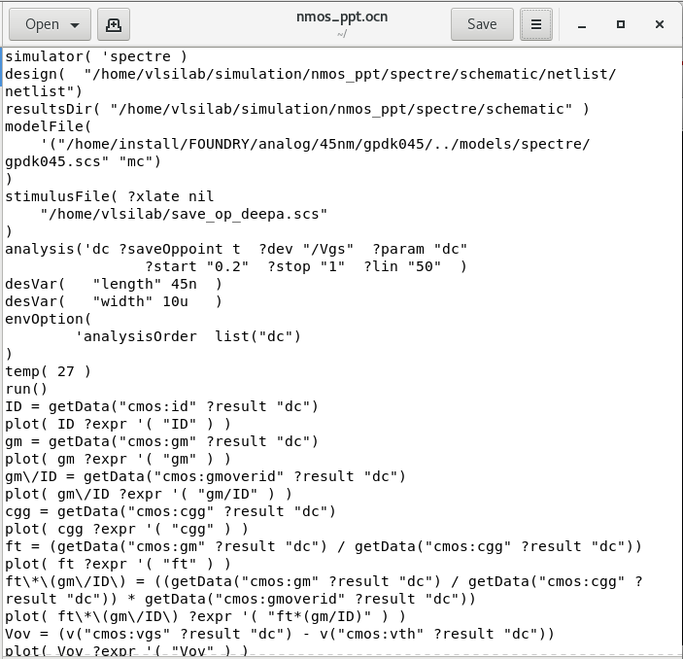
Ocean script reflects the outputs added in the ADE L window.
Ocean Script with Plot disabled
Ocean Script with Plot enabled

Slide 21
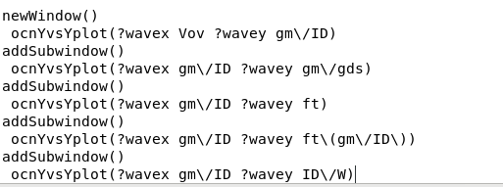
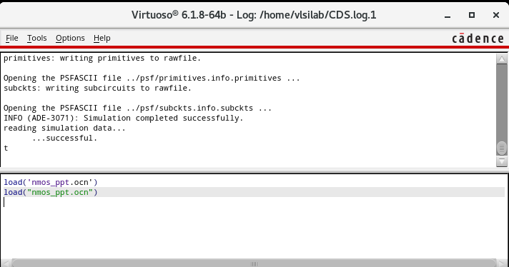
As mentioned before, Ocean scripting can automate multiple simulations without constant GUI work.
The following code can be modified to plot different parameters with respect to other parameters.
In nmos_ppt.ocn file, add these lines at the bottom ocnYvsYplot(?wavex<space>X_parameter<space>?wavey<space>Y_parameter)
To run the ocean script,
  In the log file > type load("your_ocean_script_file.ocn") > enter.

Slide 22
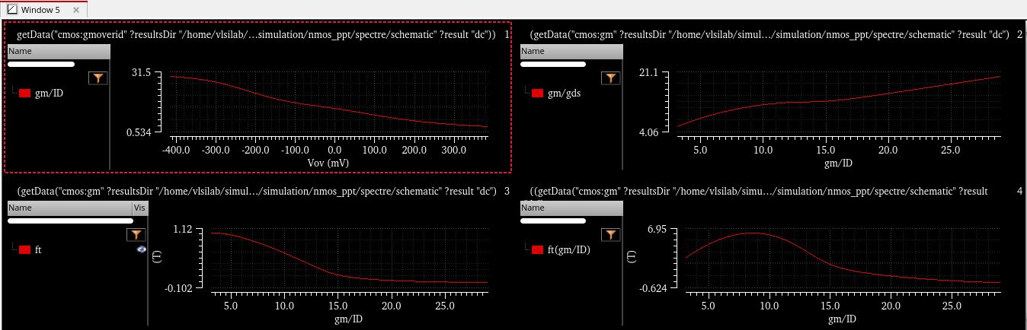
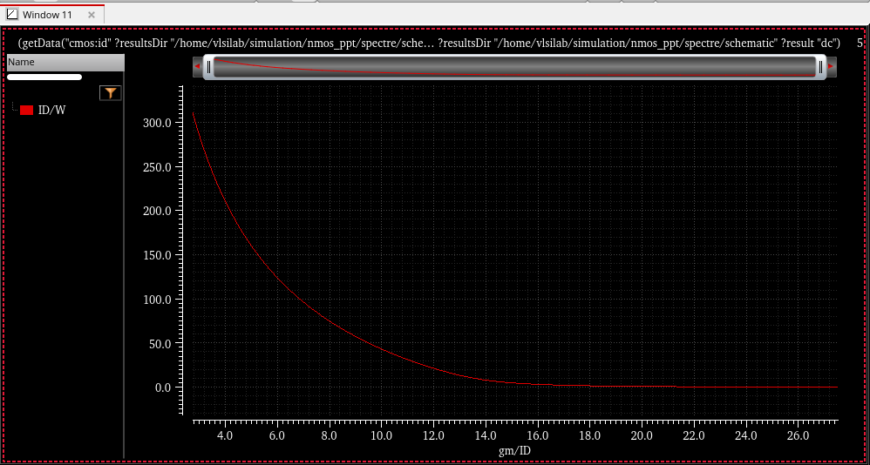
The results will be outputs with respect to gm/ID
Save the ADE L window to save the current ocean script file.

Slide 23
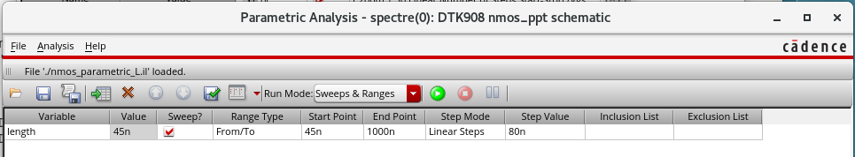
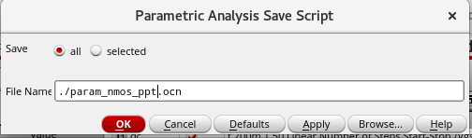
Parametric analysis using ocean scripting
In the ADE L window, tools > Parametric analysis
File>Load : Load the previously saved window "nmos_parametric_L.il".
File> Save Ocean Script.

Slide 24
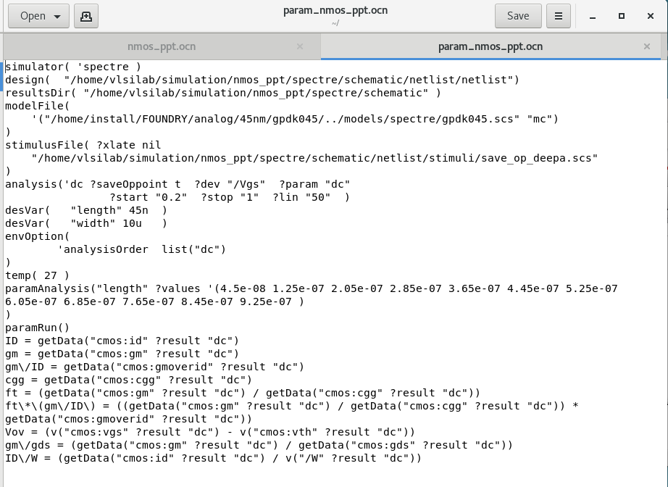
Parametric Ocean script is ready.
Copy the following section of code from nmos_ppt.ocn file into the param_nmos_ppt.ocn
Save it.
Avoid enabling Plot in ADE each time—use the code to generate graphs directly from the log file.
Run Parametric analysis : Log file > load("param_nmos_ppt.ocn") > enter

Slide 25
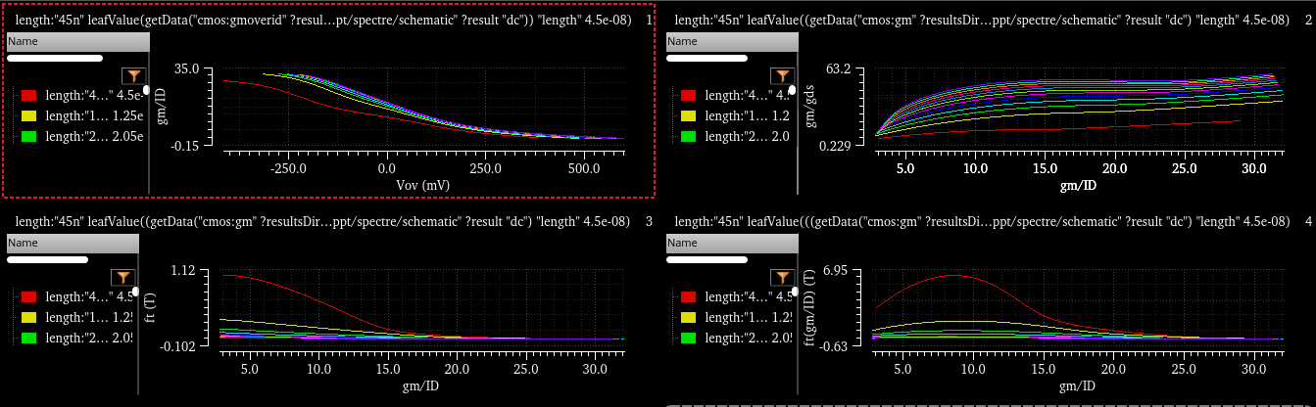
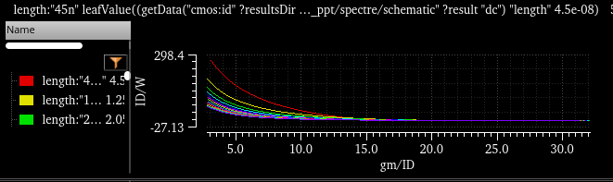
Results of Parametric analysis.

Slide 26
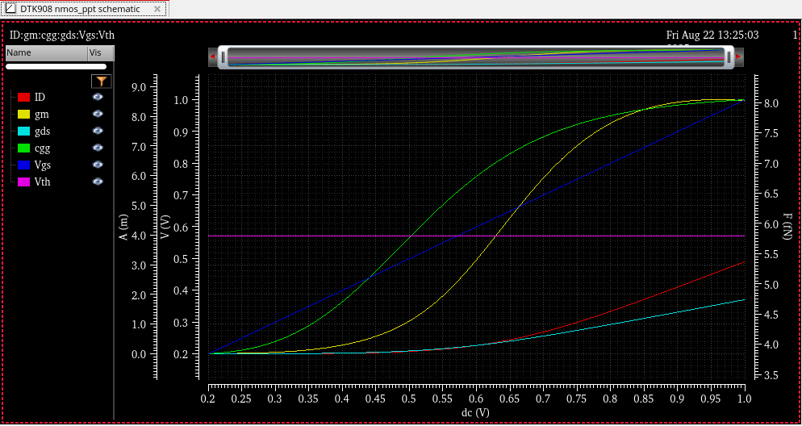
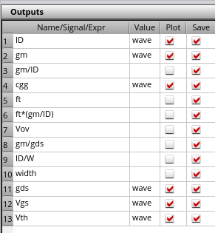
Plotting of gm/ID graphs on MATLAB
The basic idea is importing the data from the graphs and plotting them on Matlab.
Get these parameters for MATLAB:
ID, gm, cgg, gds, Vgs, Vth.
Run these.
To get the data from these signals,
  Right-click on each signal (i.e., ID, gm etc.,) > Send To> Table> Append.
  'Append' option adds each signal data-points w.r.t Vgs which is in X-axis here.

Slide 27
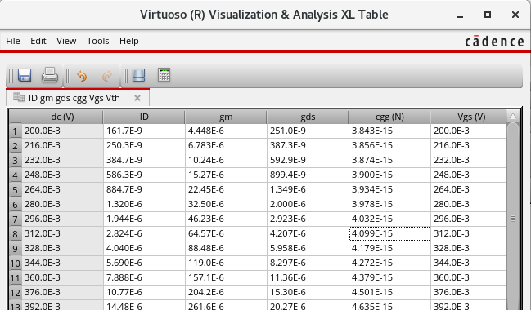
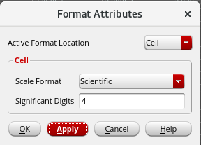
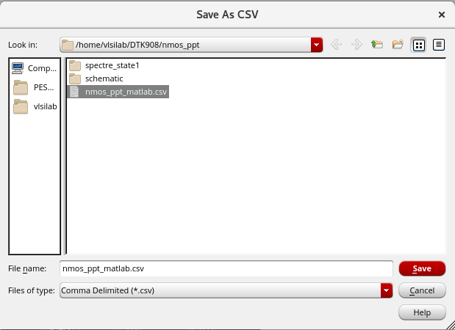
Convert these values into Scientific
Click on one column > Ctrl+A
View > Format
The table:
To export the table to a .csv file for matlab:
  File>Export

Slide 28
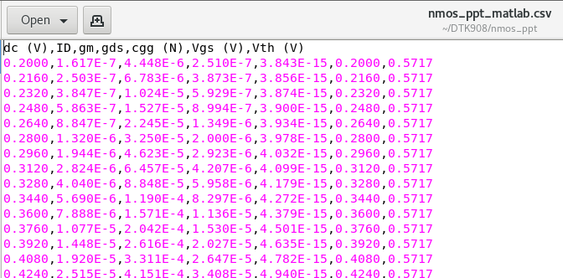
To check the .csv file,
  Go to the location of the file :
Transfer this file to Windows to Import it into MATLAB.

Slide 29
Run MATLAB
Save the "nmos_ppt_matlab.csv" file in the same folder as your "nmos_matlab_.m" file which contains the code to simulate the graphs.
Code:
data = readtable('nmos_ppt_matlab.csv')
W = 10e-6; %defined 10u
dc = data.dc_V_;
ID = data.ID;
gm = data.gm;
gds = data.gds;
cgg = data.cgg_N_;
Vgs = data.Vgs_V_;
Vth = data.Vth_V_;
gm_ID = gm./ID ;
Vov = Vgs- Vth ;
gm_gds = gm/gds;
ft = gm/(2*pi*cgg) ;
ID_W = ID./W ;

Slide 30
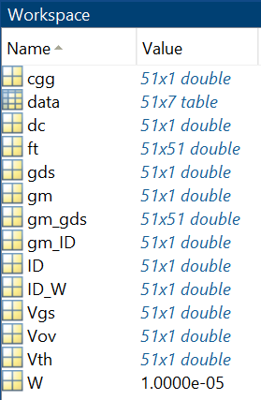
Workspace is updated. Separate tables are formed for each Variable.
Use the following code to Plot the graphs:
figure(1);
% 1. gm/ID vs Vov
subplot(2,3,1)
plot(Vov, gm_ID, 'LineWidth',1.5)
xlabel('V_{OV} (V)'); ylabel('g_m/I_D (1/V)');
title('g_m/I_D vs V_{OV}'); grid on;
% 2. gm/gds vs gm/ID
subplot(2,3,2)
plot(gm_ID, gm_gds, 'LineWidth',1.5)
xlabel('g_m/I_D (1/V)'); ylabel('g_m/g_{ds}');
title('Intrinsic Gain vs g_m/I_D'); grid on;
% 3. fT vs gm/ID
subplot(2,3,3)
plot(gm_ID, ft, 'LineWidth',1.5)
xlabel('g_m/I_D (1/V)'); ylabel('f_T (Hz)');
title('f_T vs g_m/I_D'); grid on;

Slide 31
% 4. fT*(gm/ID) vs gm/ID
subplot(2,3,4)
plot(gm_ID, ft.*gm_ID, 'LineWidth',1.5)
xlabel('g_m/I_D (1/V)');
ylabel('f_T \times (g_m/I_D)');
title('f_T \times (g_m/I_D) vs g_m/I_D');grid on;
% 5. ID/W vs gm/ID
subplot(2,3,5)
plot(gm_ID, ID_W, 'LineWidth',1.5)
xlabel('g_m/I_D (1/V)');
ylabel('I_D/W (A/m)');
title('I_D/W vs g_m/I_D'); grid on;
figure(2);
subplot(1,2,1)
plot(Vov, ID, 'LineWidth',1.5)
xlabel('V_{OV} (V)'); ylabel('I_D (A)');
title('I_D vs V_{OV}'); grid on;
subplot(1,2,2)
plot(Vov, gm, 'LineWidth',1.5)
xlabel('V_{OV} (V)'); ylabel('g_m (S)');
title('g_m vs V_{OV}'); grid on;

Slide 32
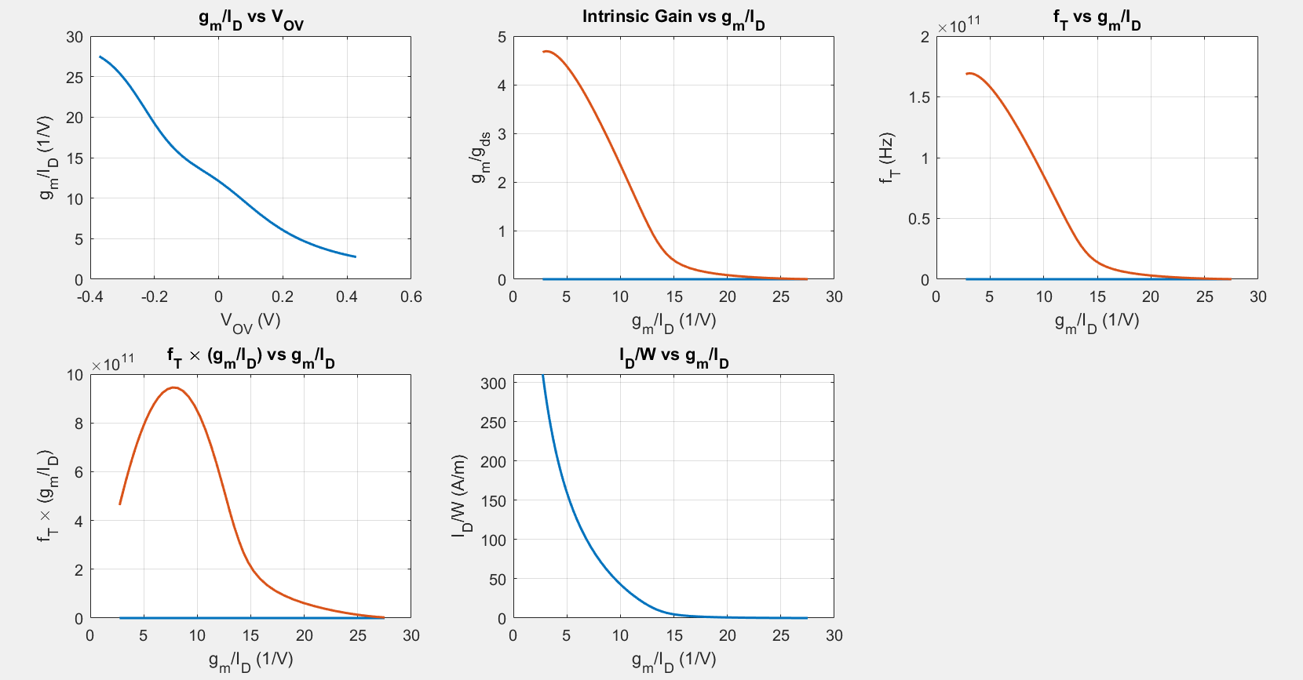
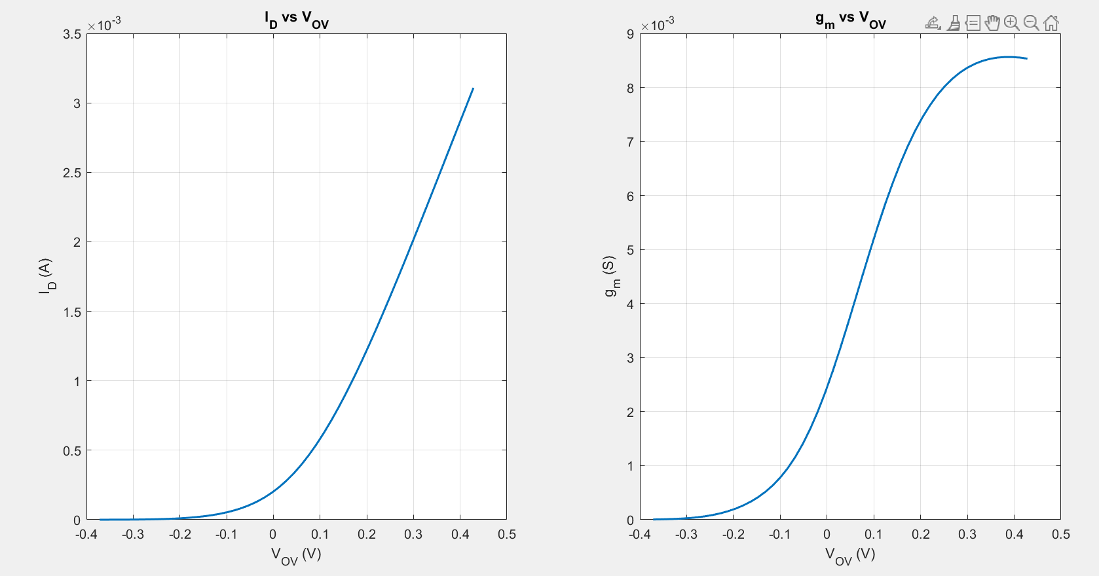
Results:

Slide 33
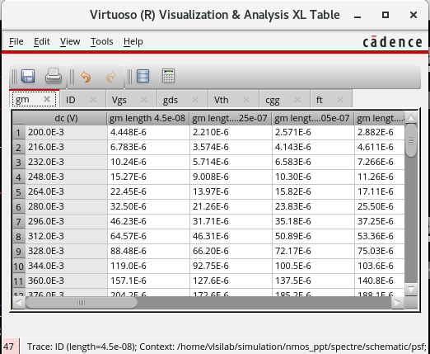
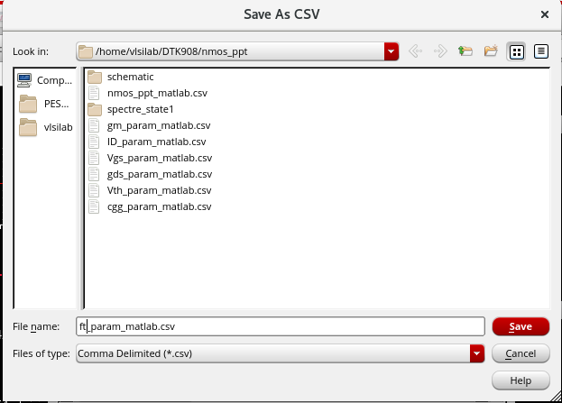
Parametric Analysis
Run Parametric analysis, get all the graphs of gm, ID, cgg, Vgs, Vth, gds w.r.t varying lengths.
Append each graph as shown below > Export them each as .csv files

Slide 34
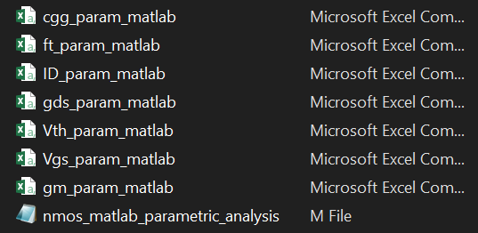
Transfer the files to Windows
  Location of the .csv files should be in the same folder as the matlab code file "nmos_matlab_parametric_analysis.m"
In the .m file, import these .csv files :
W = 10e-6; % transistor width
% ---- Read all parameter CSV files ----
ID_data = readtable('ID_param_matlab.csv');
gm_data = readtable('gm_param_matlab.csv');
gds_data = readtable('gds_param_matlab.csv');
Vgs_data = readtable('Vgs_param_matlab.csv');
Vth_data = readtable('Vth_param_matlab.csv');
ft_data = readtable('ft_param_matlab.csv');
cgg_data = readtable('cgg_param_matlab.csv');

Slide 35
% Extract channel length names from (any) table
Lvec_ID = ID_data.Properties.VariableNames(2:end);
% first common column is Vgs
Vgs = ID_data{:,1}; % Vgs column
% gm/ID
gm_ID = gm_data{:,2:end} ./ ID_data{:,2:end};
% gm/gds
gm_gds = gm_data{:,2:end} ./ gds_data{:,2:end};
% Vov = Vgs - Vth
Vov = Vgs - Vth_data{:,2:end};
% fT * (gm/ID)
ft_gmID = ft_data{:,2:end} .* gm_ID;
% ID/W
ID_W = ID_data{:,2:end} ./ W;
% Legends name of the header of columns
Lvec_ID_clean = regexprep(Lvec_ID, ...
'^IDLength(\d+)_(\d+)e_(\d+)$', '$1.$2e-$3');
% Plot all parameters wrt Vov in one window
figure;
% ---- ID vs Vov ----
subplot(3,3,1);
plot(Vov, ID_data{:,2:end}, 'LineWidth', 1.2);
xlabel('V_{OV} (V)'); ylabel('I_D (A)');
title('I_D vs V_{OV}'); grid on;
% ---- gm vs Vov ----
subplot(3,3,2);
plot(Vov, gm_data{:,2:end}, 'LineWidth', 1.2);
xlabel('V_{OV} (V)'); ylabel('g_m (S)');
title('g_m vs V_{OV}'); grid on;
% ---- gm/ID vs Vov ----
subplot(3,3,3);
plot(Vov, gm_ID, 'LineWidth', 1.2);
xlabel('V_{OV} (V)'); ylabel('g_m/I_D');
title('g_m/I_D vs V_{OV}'); grid on;

Slide 36
% ---- gm/gds vs Vov ----
subplot(3,3,4);
plot(Vov, gm_gds, 'LineWidth', 1.2);
xlabel('V_{OV} (V)'); ylabel('g_m/g_{ds}');
title('g_m/g_{ds} vs V_{OV}'); grid on;
% --- fT vs Vov ----
subplot(3,3,5);
plot(Vov, ft_data{:,2:end}, 'LineWidth', 1.2);
xlabel('V_{OV} (V)'); ylabel('f_T (Hz)');
title('f_T vs V_{OV}'); grid on;
% ---- fT*(gm/ID) vs Vov ----
subplot(3,3,6);
plot(Vov, ft_gmID, 'LineWidth', 1.2);
xlabel('V_{OV} (V)'); ylabel('f_T*(g_m/I_D)');
title('f_T*(g_m/I_D)'); grid on;
% ---- ID/W vs Vov ----
subplot(3,3,7);
plot(Vov, ID_W, 'LineWidth', 1.2);
xlabel('V_{OV} (V)'); ylabel('I_D/W (A/m)');
title('I_D/W vs V_{OV}'); grid on;
% Add a single legend outside plots
legend(Lvec_ID_clean, 'Interpreter','none','Location','eastoutside');
sgtitle('All Parameters vs V_{OV}');

Slide 37

Results:

